Slide 1
Tutorial on Nonlinear Reduced Order Modelling
Vizzaccaro Advanced Structural Dynamics

Slide 2
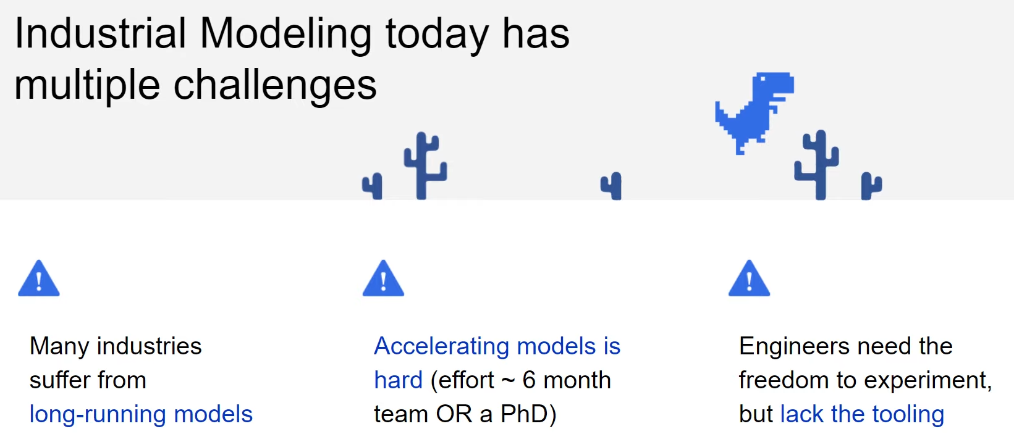
Why ROMs?
High fidelity Models:
High number of DOFs
Run full dynamic simulations:
Hours-days
Hard to accelerate computationally
The dynamics live in a much lower dimensional space
With ROM:
Seconds-minutes
Notes:
Just read
Engineers need the freedom to explore but lack of tools!

Slide 3
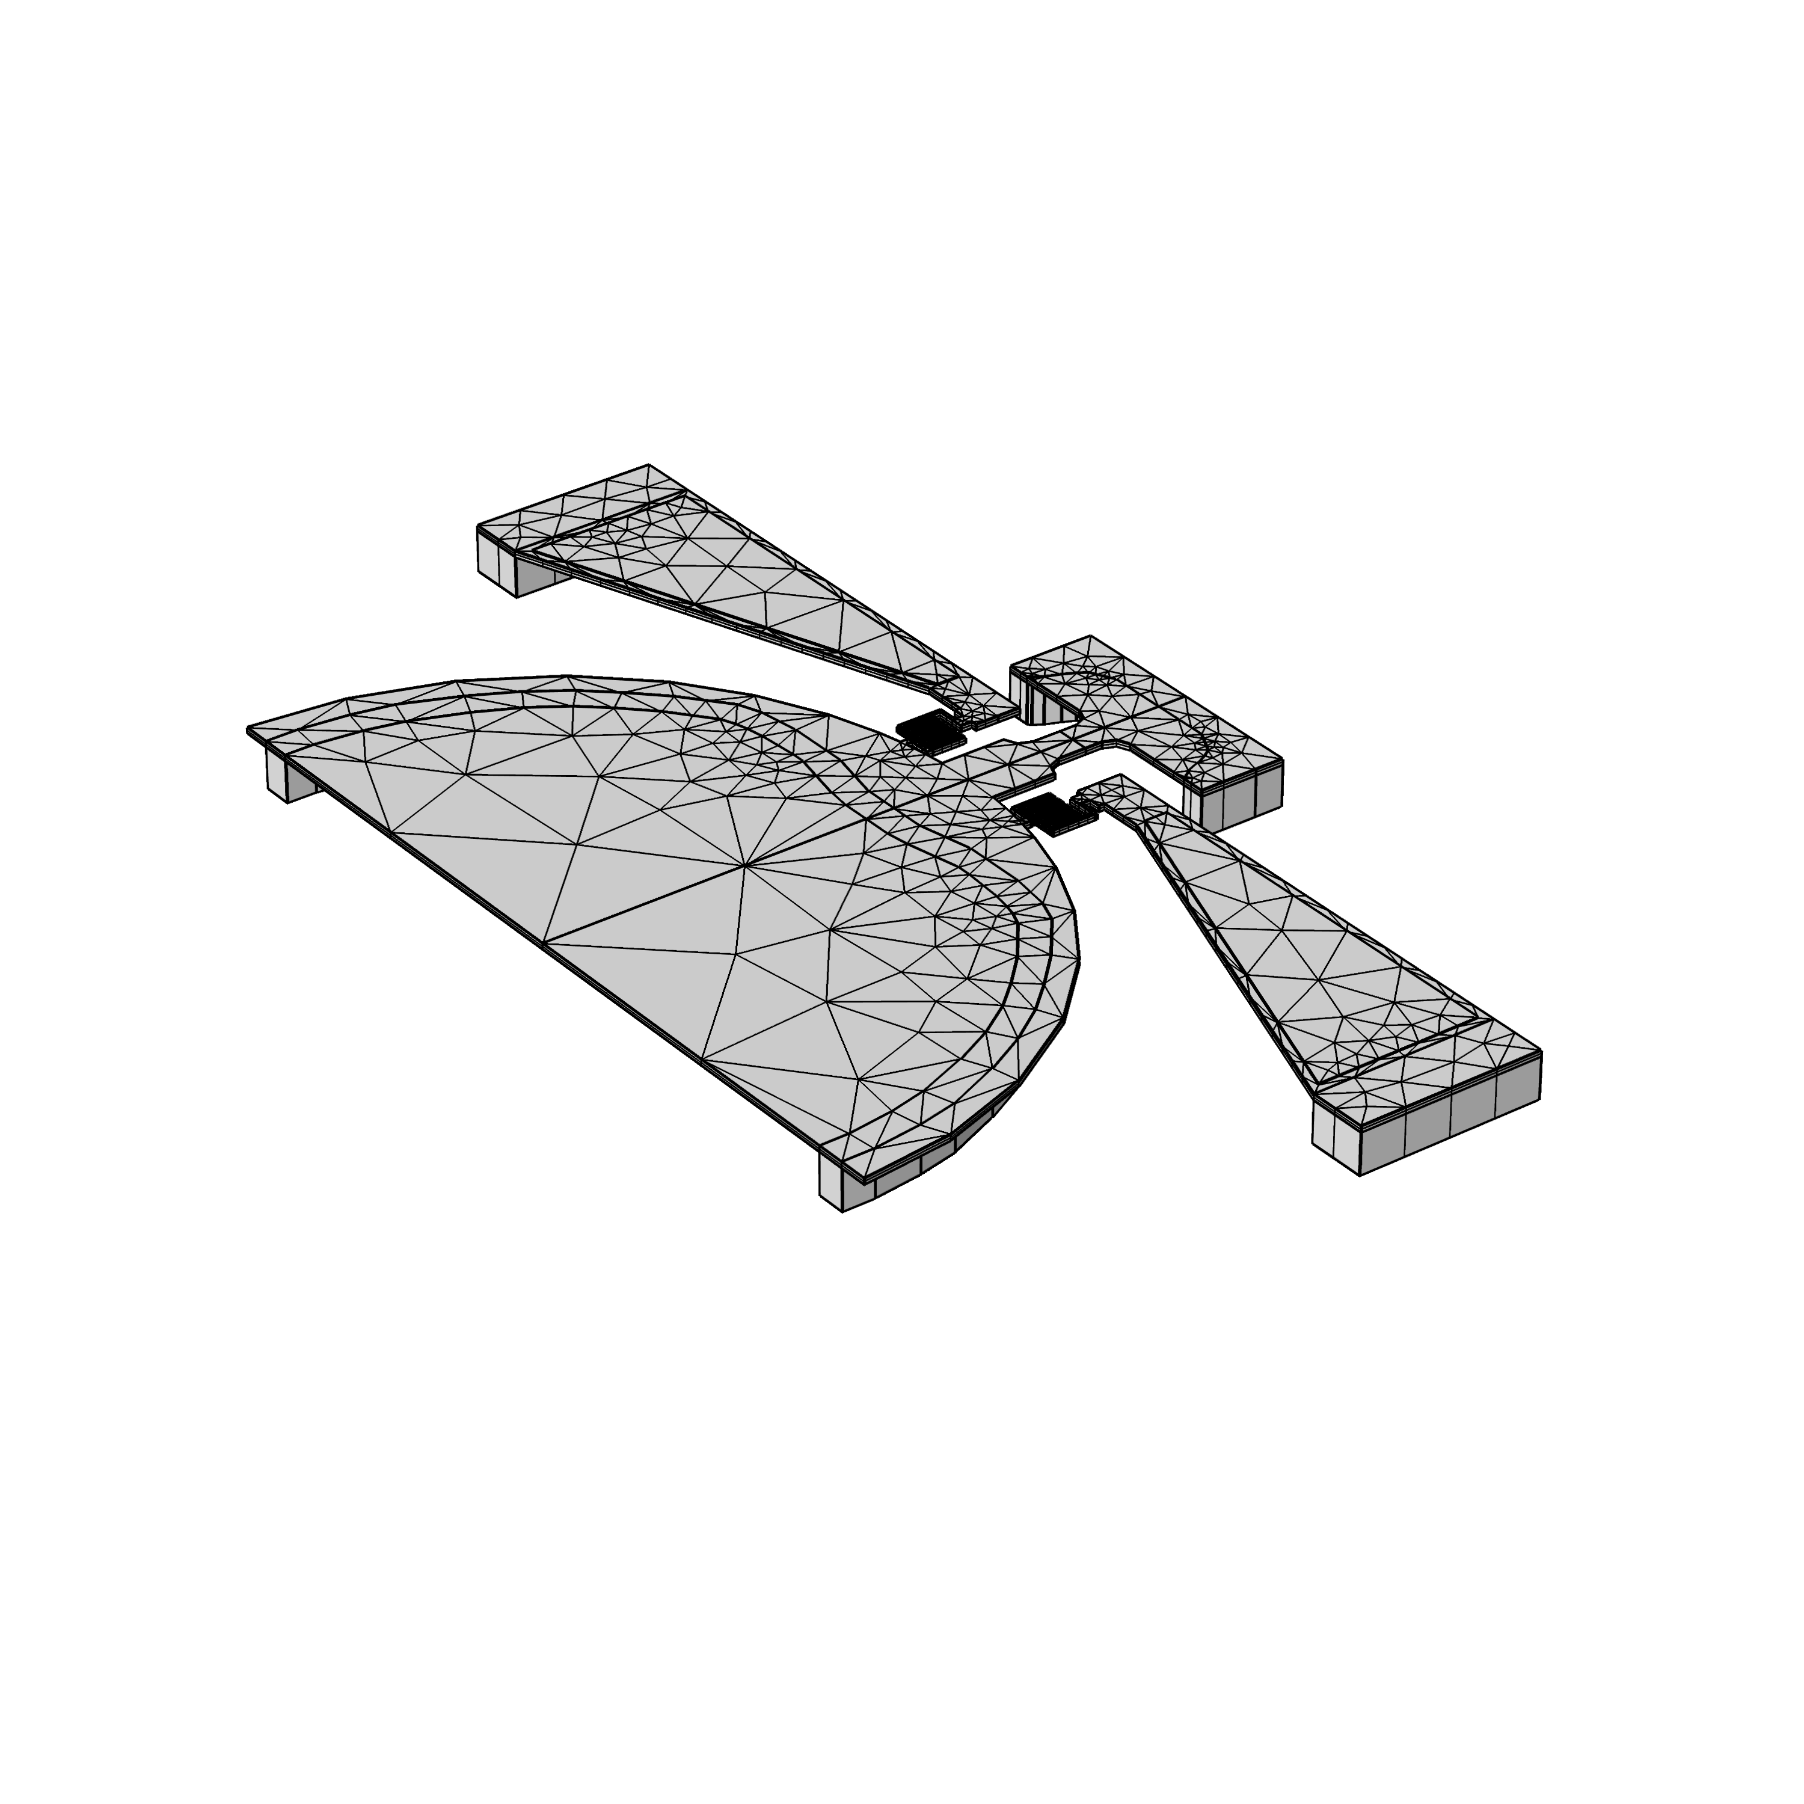
Reduced Order Modelling (ROM)
Large scale 3D finite elements model
Capture the characteristic dynamics
with low dimensional models
Desired Properties:
Small number of parameters
Physically interpretable
From FE model
Fast yet accurate
Nonlinear Dynamical system
with up to Millions of degrees of freedom

Slide 4
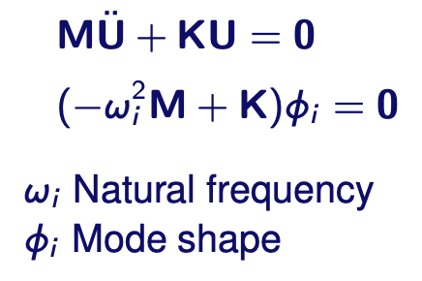
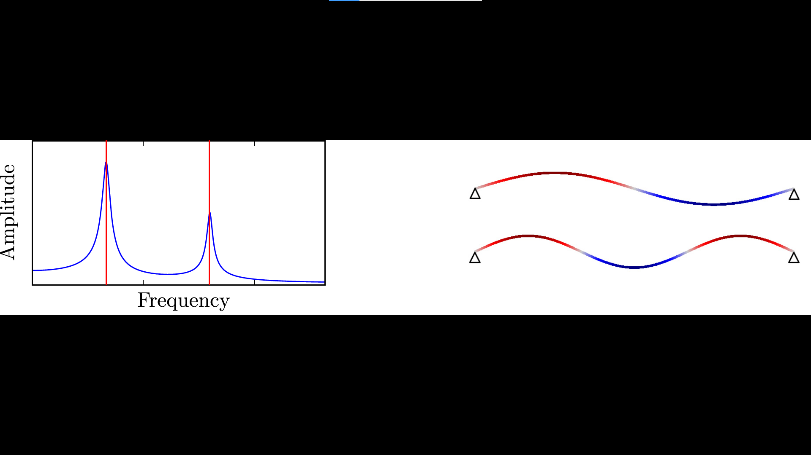
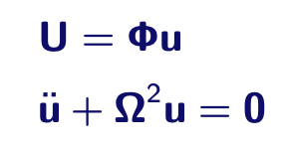
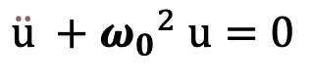
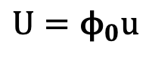
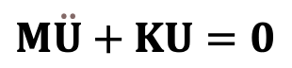
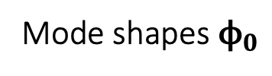
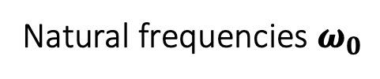
The simplest ROM
Large scale 3D finite elements model with up to millions of degrees of freedom:
Change of Coordinates
Linear Modal Analysis is the
most trivial of ROMs
Reduced Dynamics
$$U={\text{ϕ}}_{0}u$$
$$\ddot{u} +{ω_{0}}^{2} u=0$$
Natural frequencies $ω_{0}$
$$M\ddot{U}+KU=0$$
Mode shapes ${\text{ϕ}}_{0}$

Slide 5
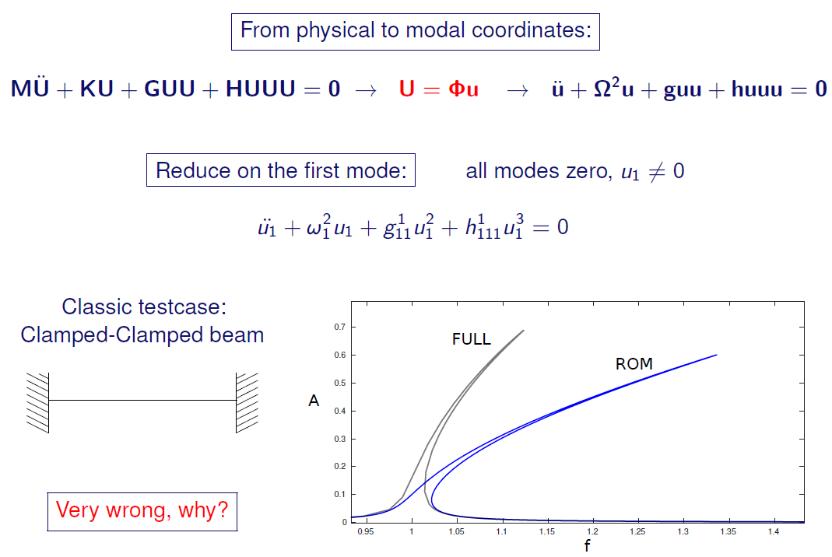
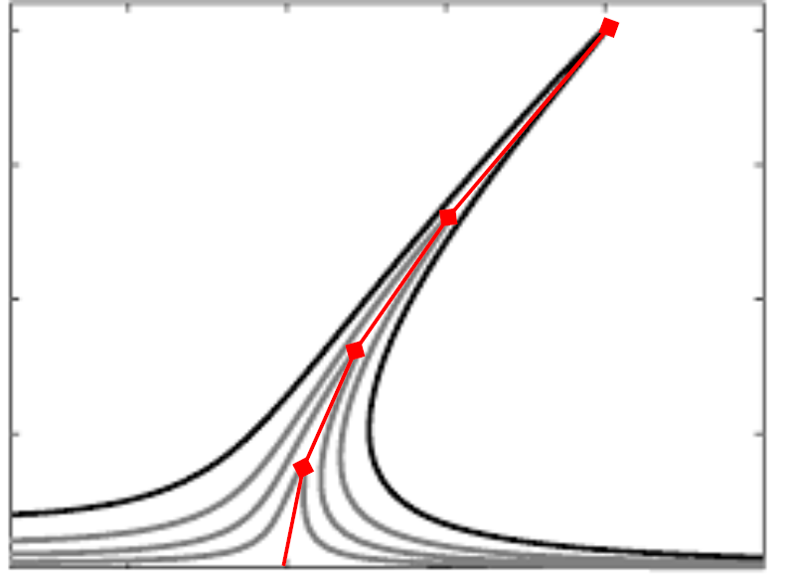
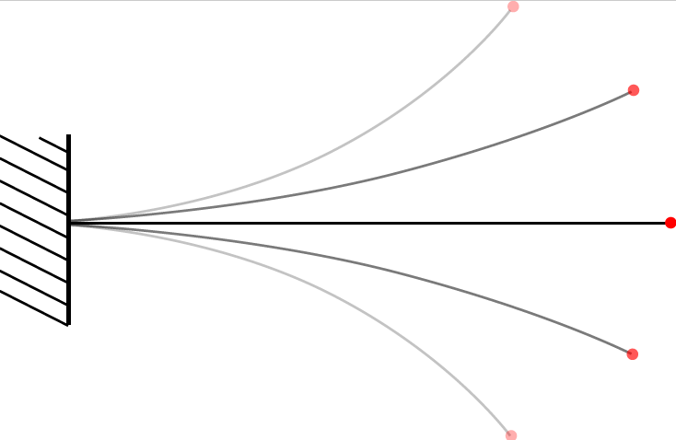
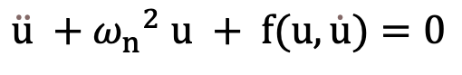
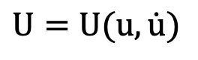
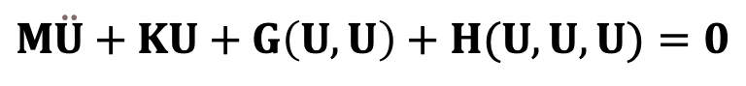
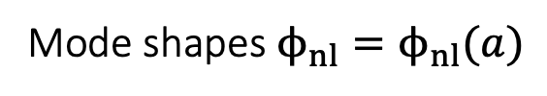
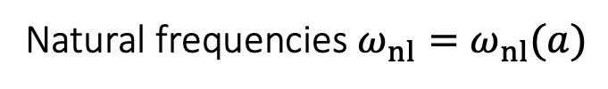
What happens when the system is Nonlinear?
Large scale 3D finite elements model with up to millions of degrees of freedom:
Natural frequencies $ω_{nl}=ω_{nl}(a)$
Mode shapes ${\text{ϕ}}_{nl}={\text{ϕ}}_{nl}(a)$
Change of Coordinates
$$U=U(u,\dot{u})$$
The two main ingredients
of every Nonlinear ROM
Reduced Dynamics
$$\ddot{u} +{ω_{n}}^{2} u + f(u,\dot{u})=0$$
$$M\ddot{U}+KU+G\left(U,U\right)+H(U,U,U)=0$$

Slide 6
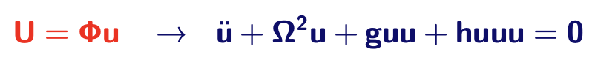
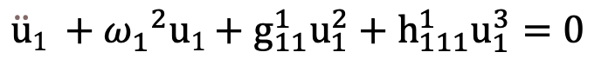

Naïve approach
Large scale FE model:
Reduced Dynamics
$$M\ddot{U}+KU+G\left(U,U\right)+H(U,U,U)=0$$
$$\ddot{u}1 +{ω_{1}}^{2}u1+g_{11}^{1}u_{1}^{2}+h_{111}^{1}u_{1}^{3}=0$$
Notes:
Mention full transformation first, then all u=0 except u1.

Slide 7
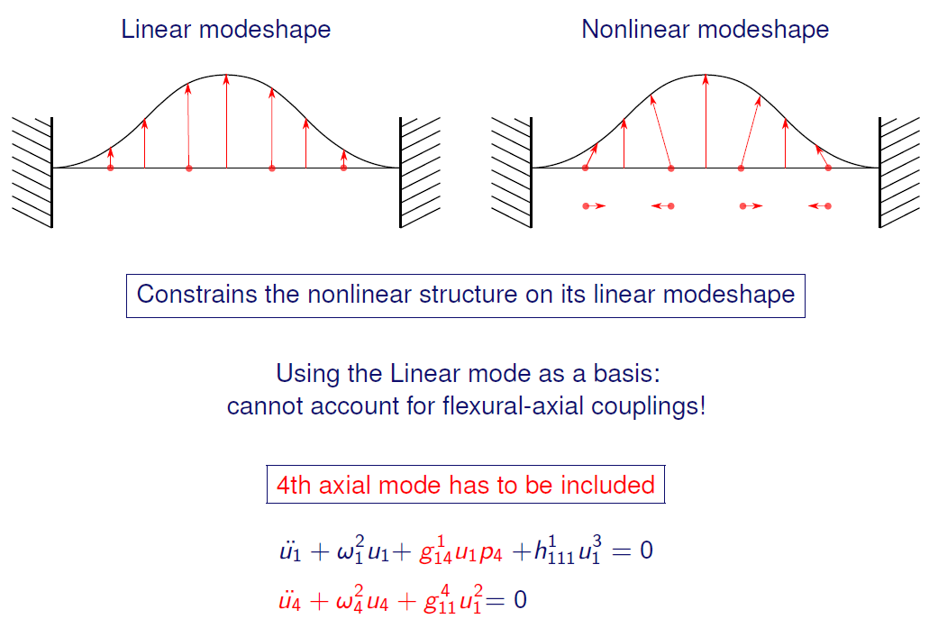
Membrane bending couplings

Slide 8
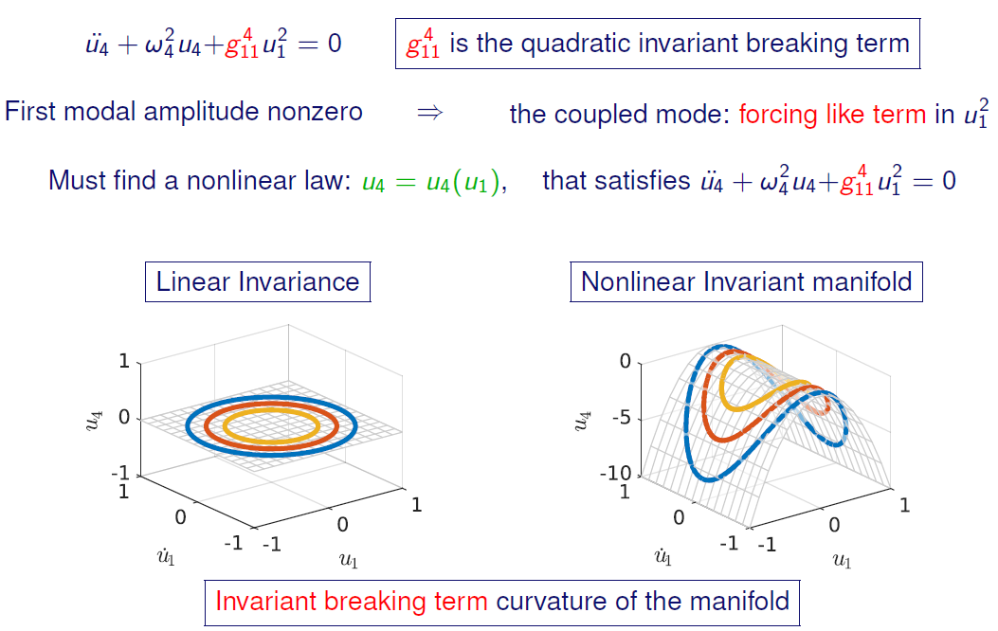
Invariant breaking terms

Slide 9
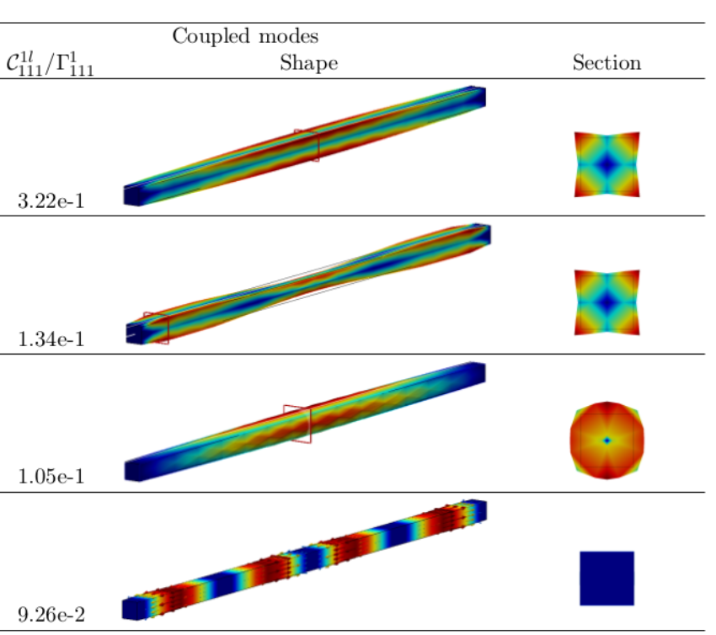
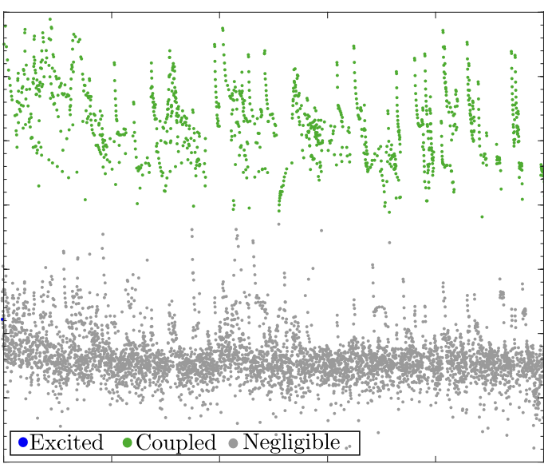
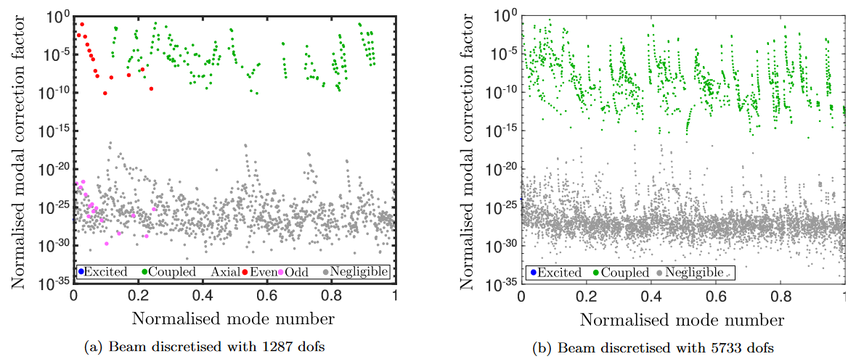
So what’s the problem?
Many modes coupled to a single master mode
Distributed all over the full spectrum
(Q1) How can we find them?
(Q2) How can we ‘enslave’ them?

Slide 10
Outline
ROM by condensation
Linear VS Nonlinear ROMs
ROM by projection
ROM by invariance

Slide 11
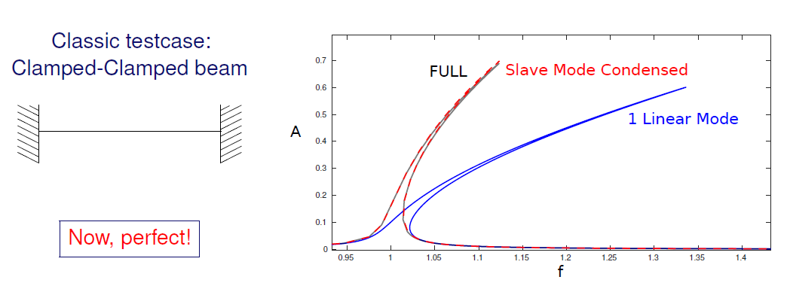
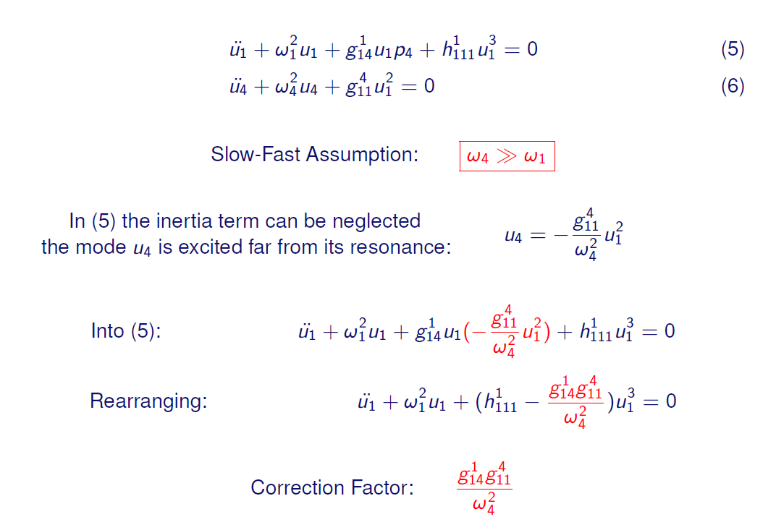
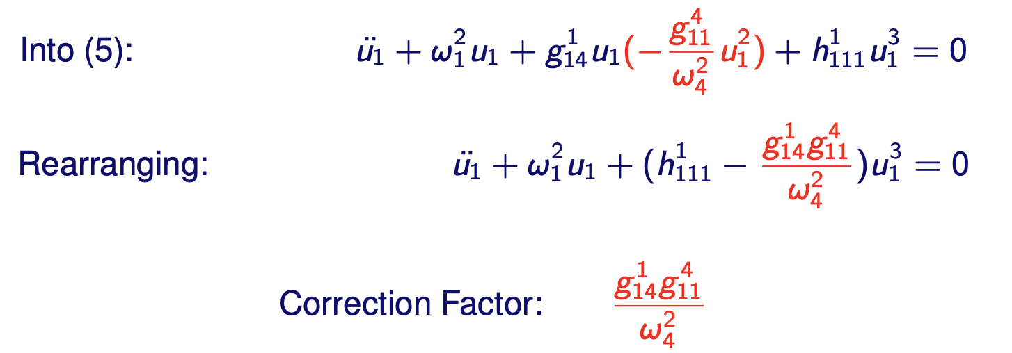
(A2) Static condensation (1D beam elements)

Slide 12
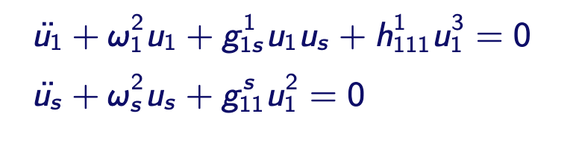

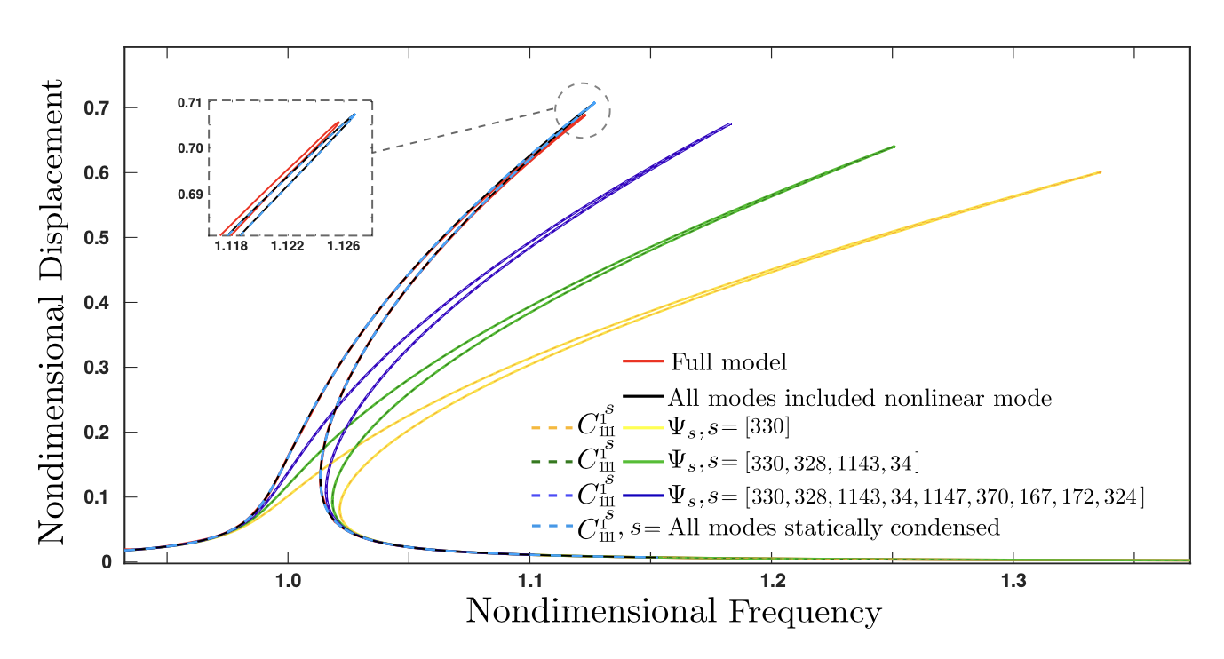
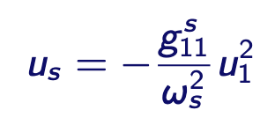
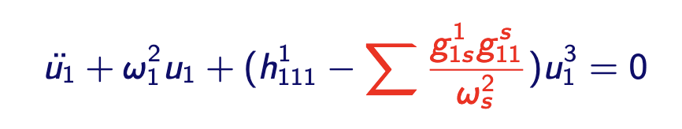
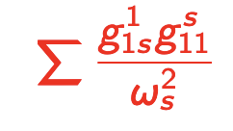
(A2) Static condensation (3D beam elements)
(Q1) How can we find them?

Slide 13
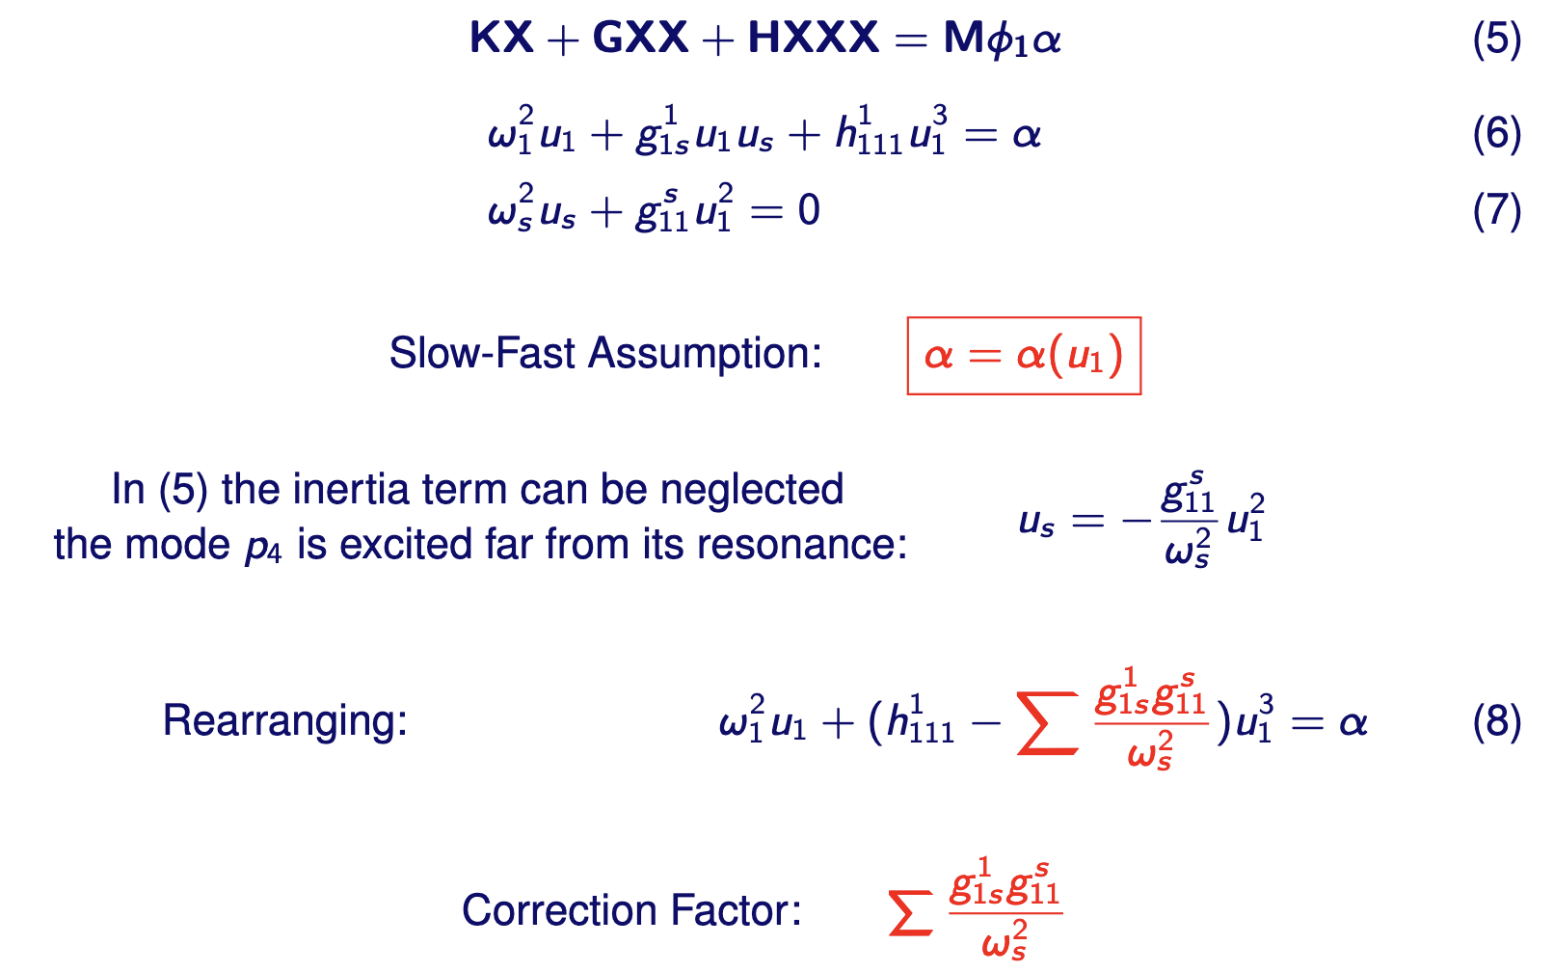
(A1) EITHER.. Implicit condensation (ICE)

Slide 14
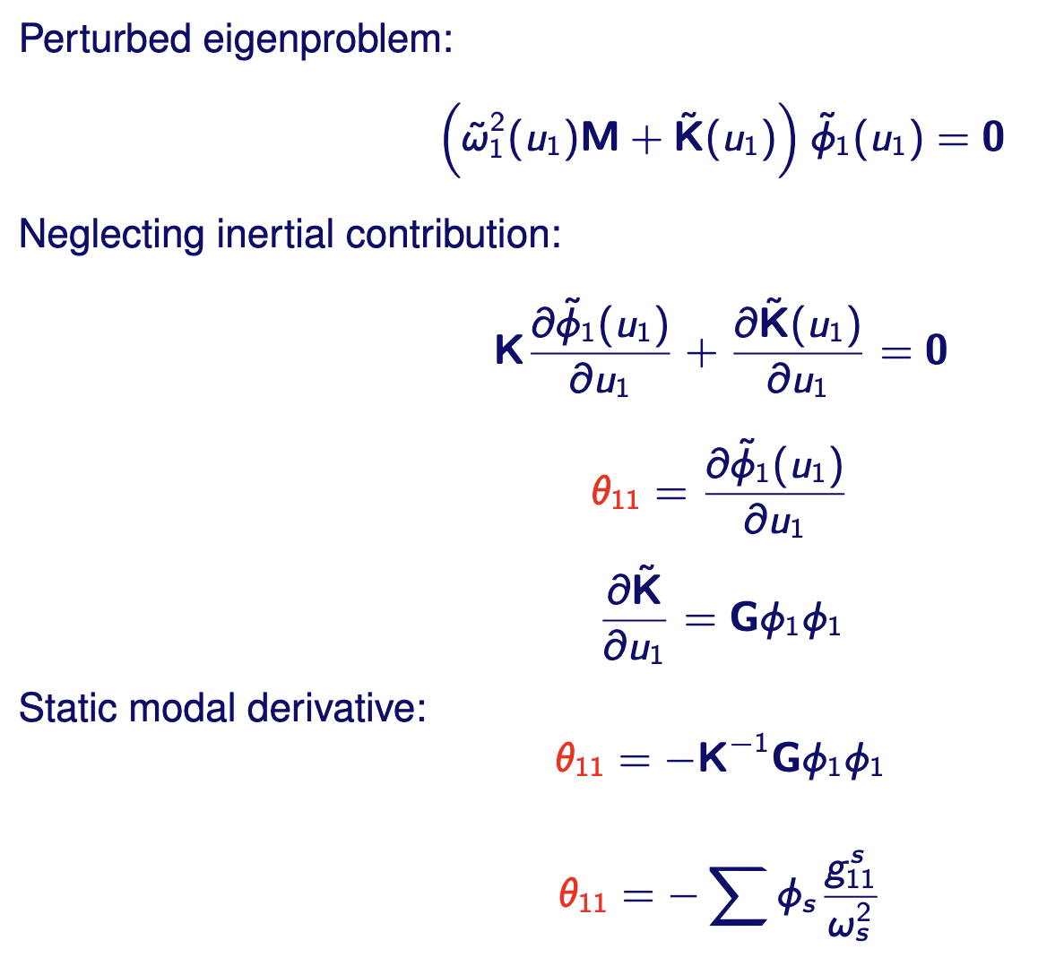
(A1) OR.. Static Modal Derivative (SMD)
_
2
2

Slide 15
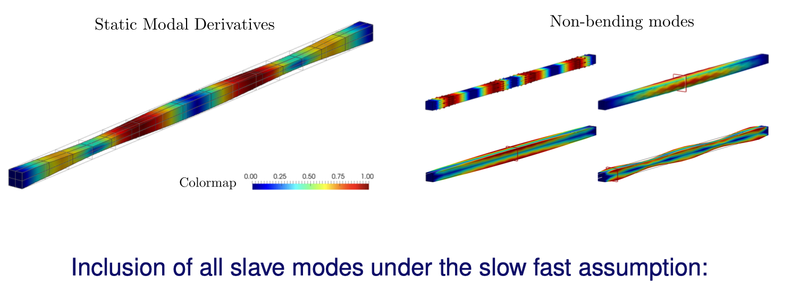
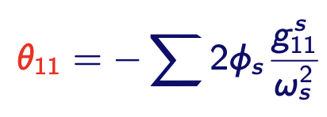
(A1) OR.. Static Modal Derivative (SMD)

Slide 16
Recap so far
Finding the coupling (A1)
either by nonlinear static analysis: ICE/POD (inverse problem)
or by direct force computation: SMD (direct problem + linear solve)
Including the found couplings (A2)
either keeping the found modes in as an additional DOF (linear ROM)
or keeping the aggregated vector in as an additional DOF: dual modes (linear ROM)
Or condensing the couplings and only keeping master: (nonlinear ROM)
Coming up other nonlinear ROMs (A2)
ROM by projection: QM/IC-ICE
ROM by invariance: SP/NF/SSM/DNF/DPIM

Slide 17
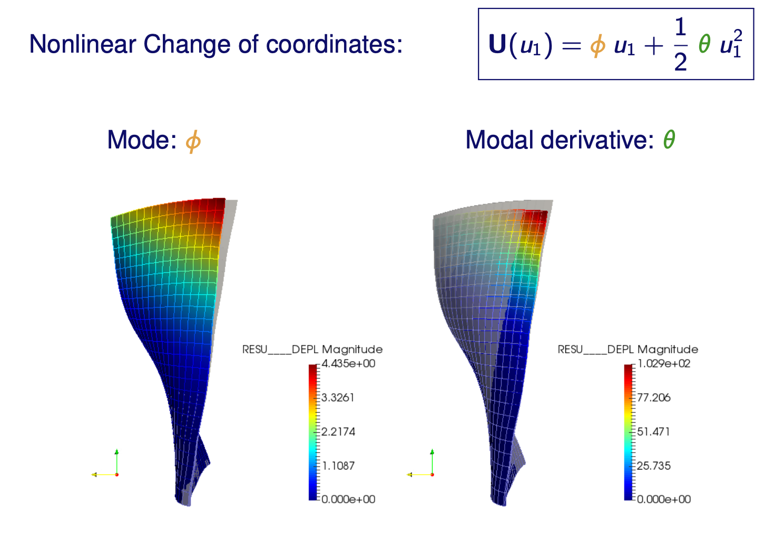
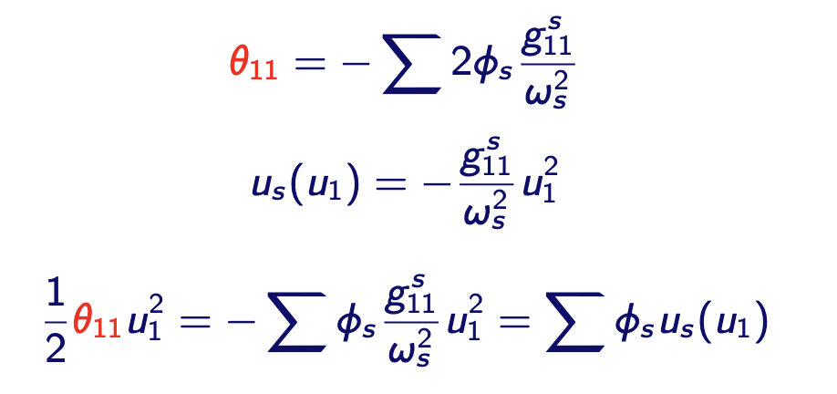
(A2) Intuition on quadratic manifold (QM)

Slide 18
(A2) Intuition on quadratic manifold (QM)

Slide 19
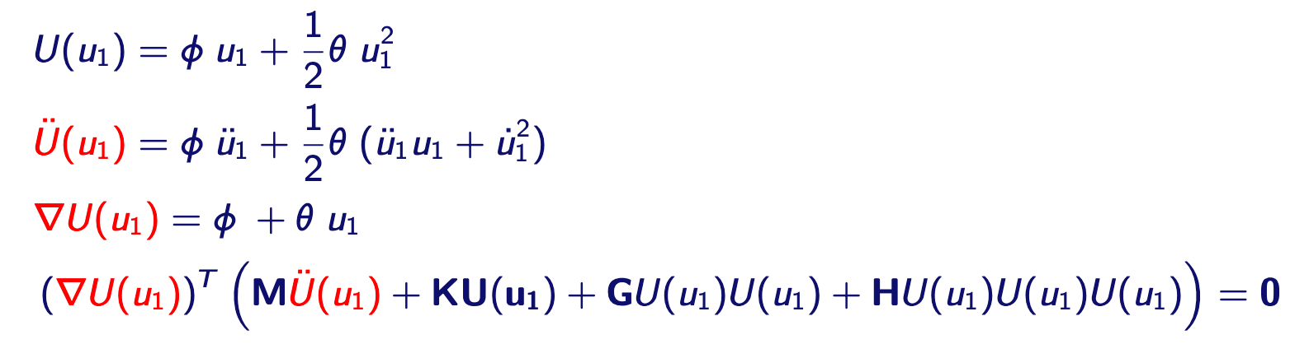
ROM by projection (QM / IC-ICE)
Nonlinear change of coordinates
Projection on tangent space!
Reduced dynamics equation:

Slide 20
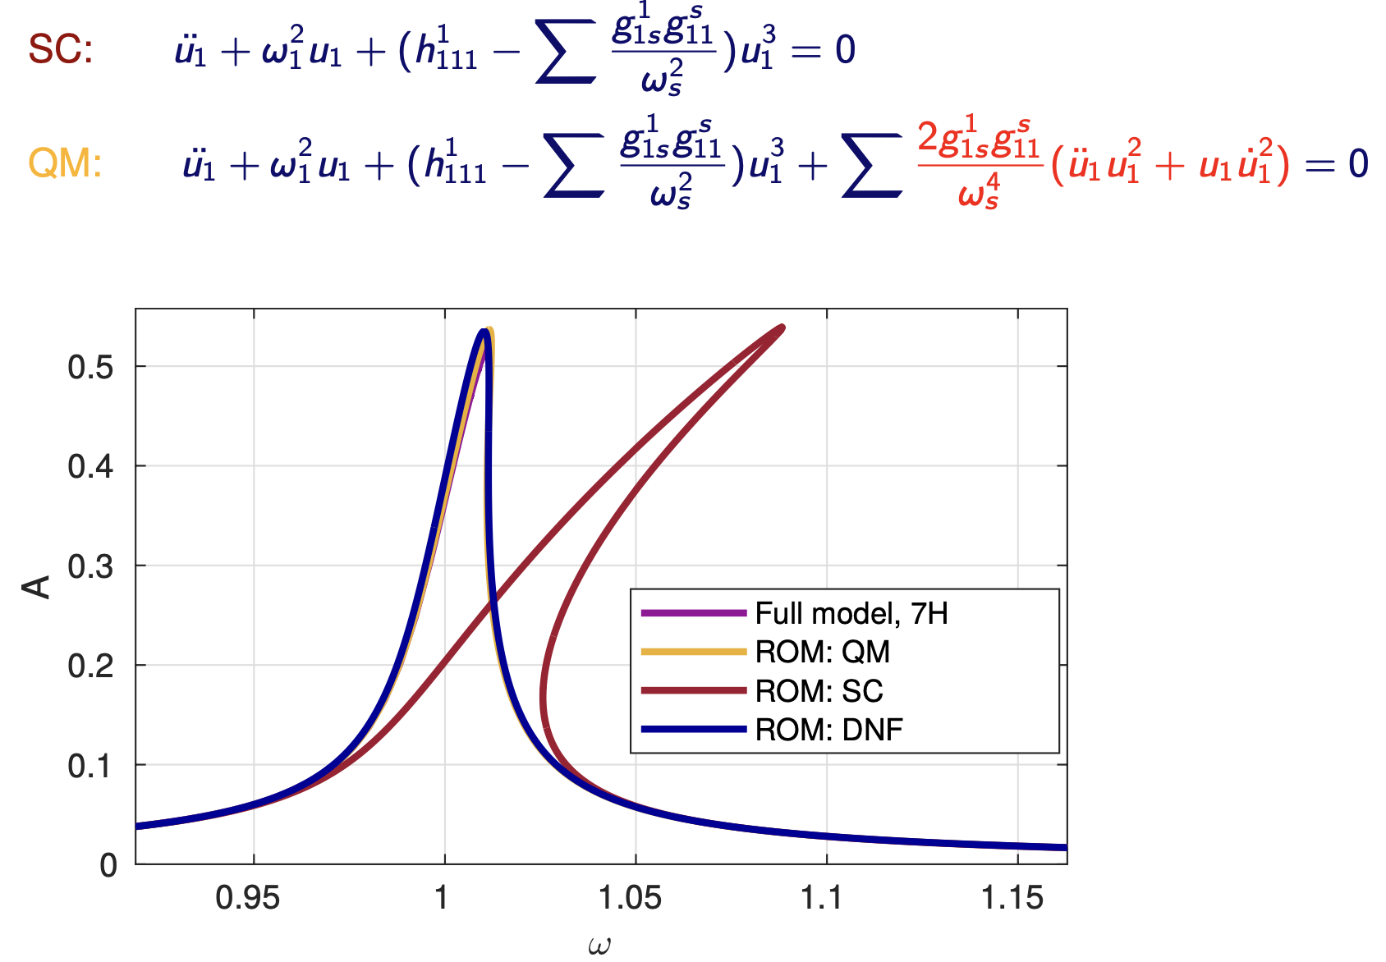
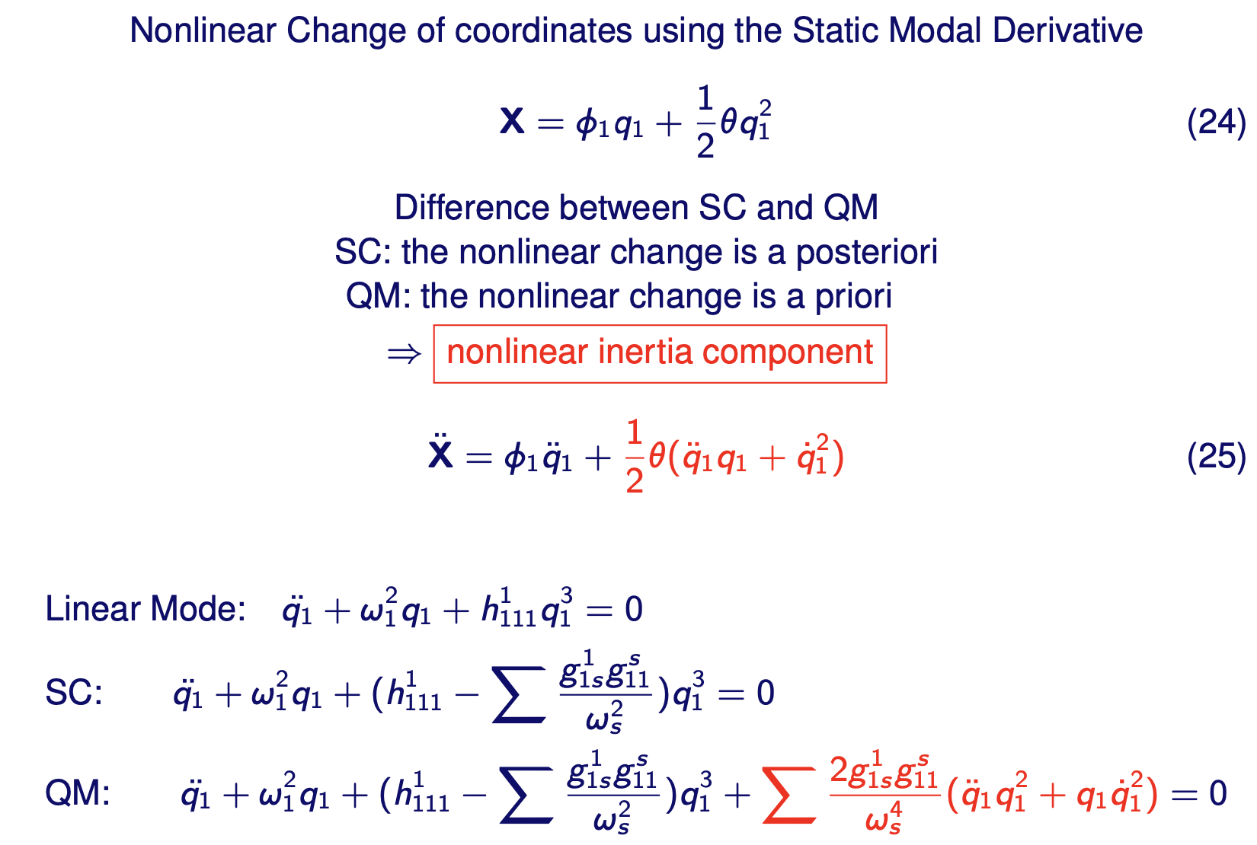
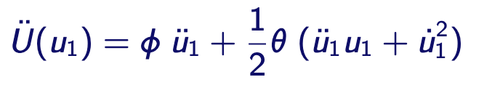
(A2) Inertial nonlinearity in QM
Cantilever beam

Slide 21
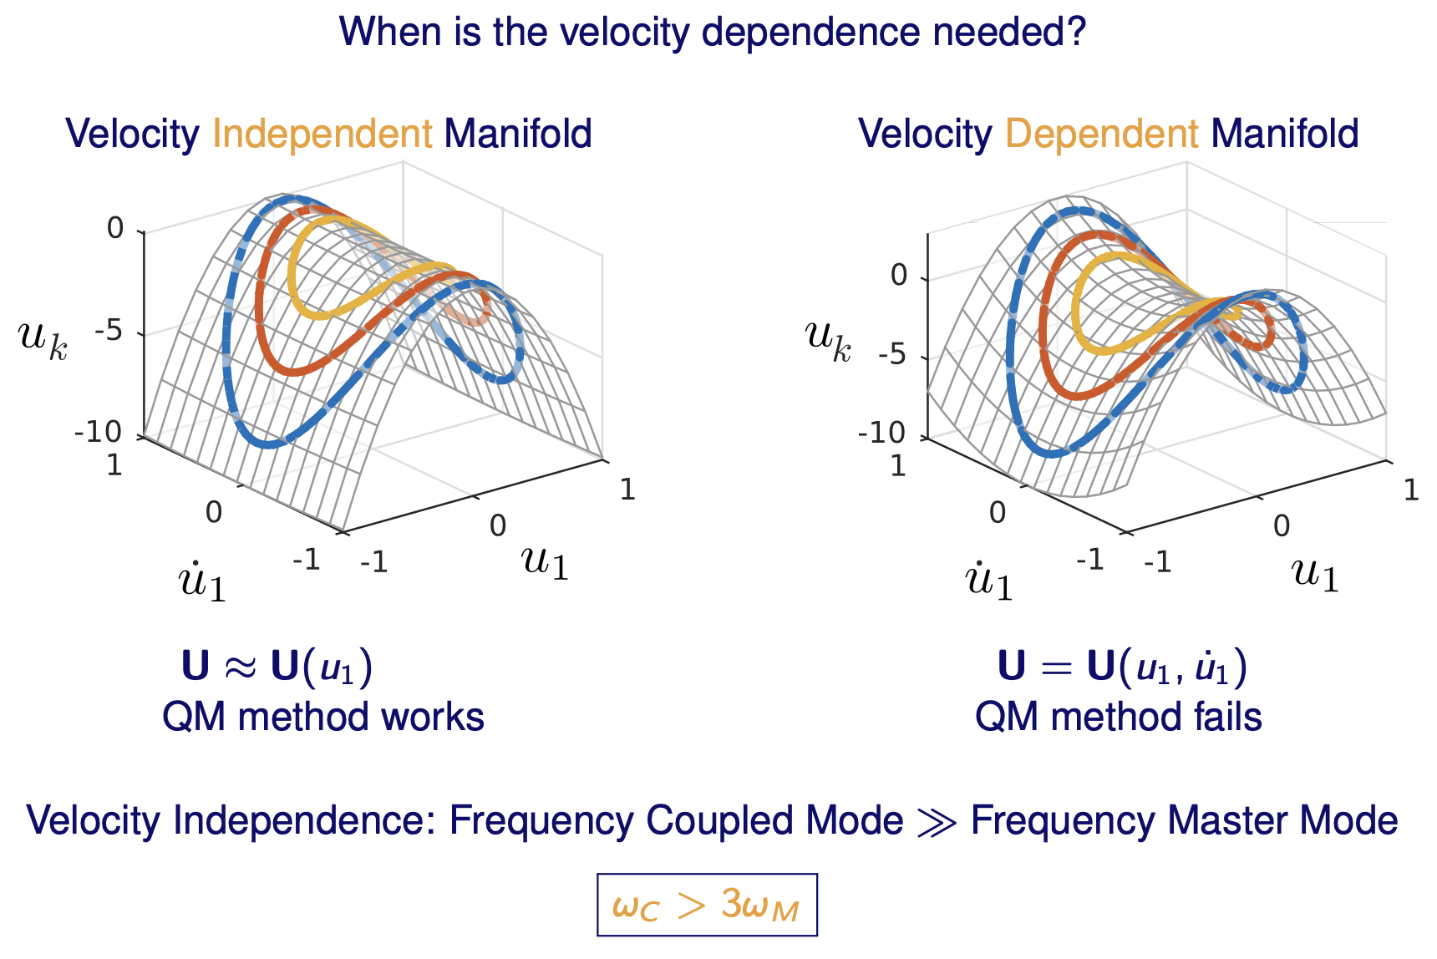
Displacement only change of coordinates
Velocity
dependent
manifold
Nonlinear change of coordinates
Velocity
independent
manifold

Slide 22
When is it needed?

Slide 23
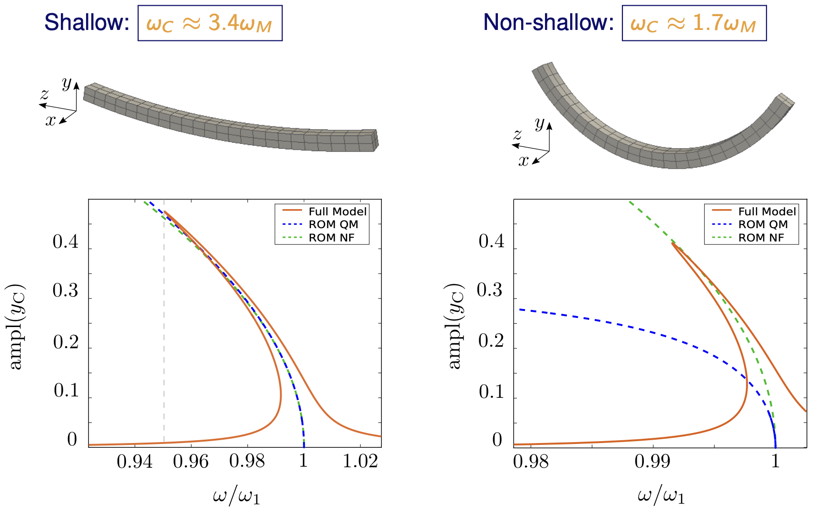
Example shallow VS non-shallow arch

Slide 24
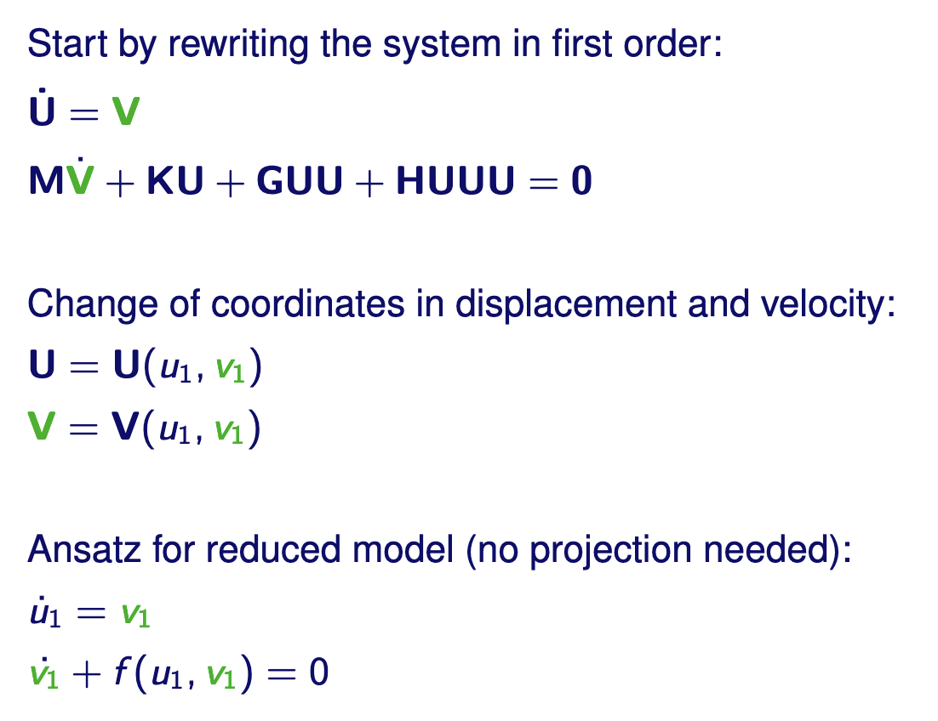
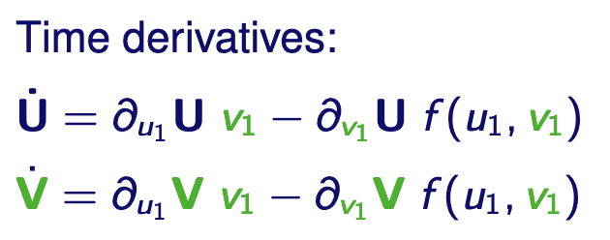
(A2) ROM by invariance (Shaw-Pierre SP)

Slide 25
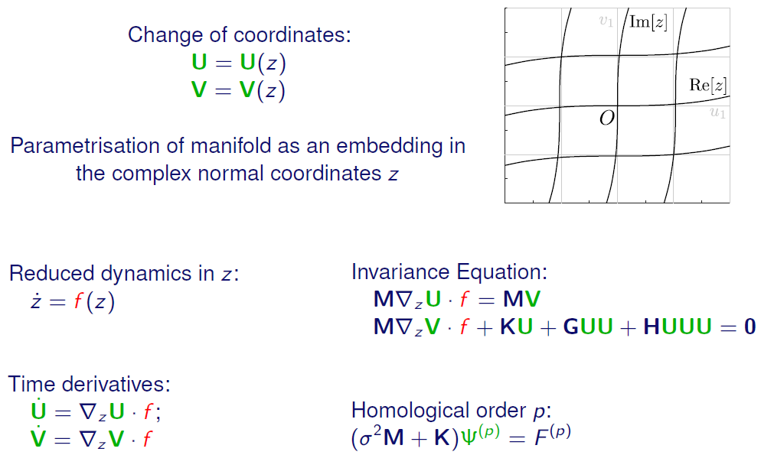
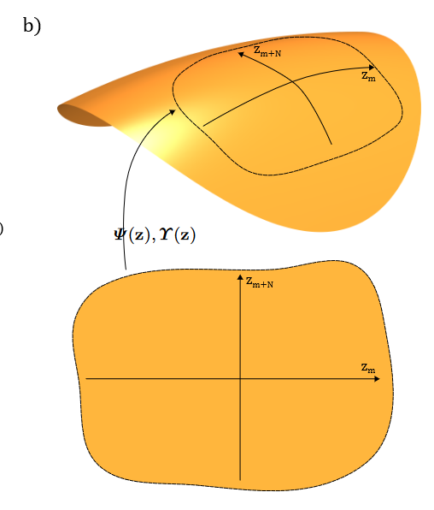
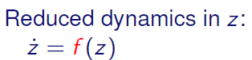
(A2) ROM by invariance (Normal Form Style)

Slide 26


(A2) Invariance equation (SP/SSM/DNF/DPIM)
2

Slide 27

(A2) Velocity dependent manifold

Slide 28

Recap

Slide 29

SC/ICE

Slide 30

QM/IC-ICE

Slide 31

SP/SSM/DNF/DPIM

Slide 32
Thank you for your attention
(SMD) Idelsohn, S.R., Cardona, A.: A reduction method for nonlinear structural dynamic analysis. Comput. Methods Appl. Mech. Eng. 49(3), 253–279 (1985)
(SP) Shaw, S., Pierre, C.: Non-linear normal modes and invariant manifolds. Journal of sound and Vibration 150 (1), 170-173 (1991)
(STEP) Muravyov, A.A., Rizzi, S.A.: Determination of nonlinear stiffness with application to random vibration of geometrically nonlinear structures. Comput. Struct. 81(15), 1513–1523 (2003)
(ICE) Hollkamp, J.J., Gordon, R.W.: Reduced-order models for non-linear response prediction: implicit condensation and expansion. J. Sound Vib. 318, 1139–1153 (2008)
(Dual Modes) Kim, K., Radu, A.G., Wang, X., Mignolet, M.P.: Nonlinear reduced order modeling of isotropic and functionally graded plates. Int. J. Non-Linear Mech. 49, 100–110 (2013)
(ICE) Kuether, R.J., Allen, M.S.: A numerical approach to directly compute nonlinear normal modes of geometrically nonlinear finite element models. Mech. Syst. Signal Process. 46(1), 1–15 (2014)
(SMD) Weeger, O., Wever, U., Simeon, B.: On the use of modal derivatives for nonlinear model order reduction. Int. J. Numer. Methods Eng. 108(13), 1579–1602 (2016)
(QM) Jain, S., Tiso, P., Rutzmoser, J.B., Rixen, D.J.: A quadratic manifold for model order reduction of nonlinear structural dynamics. Comput. Struct. 188, 80–94 (2017)
(DNF/SP/NF) Vizzaccaro, A., Shen, Y., Salles, L., Blahos, J., Touzé, C.: Direct computation of nonlinear mapping via normal form for reduced-order models of finite element nonlinear structures. CMAME. (2020)
(IC-ICE) Nicolaidou, E., Hill, T.L., Neild, S.A.: Indirect reduced order modelling: using nonlinear manifolds to conserve kinetic energy. Proc. R. Soc. A. 476, 20200589 (2021)
(SSM/SP/NF) Jain, S., Haller, G.: How to compute invariant manifolds and their reduced dynamics in high-dimensional finite-element models. Nonlinear Dyn. (2021)
(DPIM/SP/NF) Vizzaccaro, A., Opreni, A., Salles, L., Frangi, A., Touze, C.: High order direct parametrisation of invariant manifolds for model order reduction of finite element structures: application to large amplitude vibrations and uncovering of a folding point. Nonlinear Dyn (2022).

